Slide 1


Azərbaycan Dövlət Neft və Sənaye Universiteti
Calculus
Multivariable

Slide 2
Conjugates and Division of Complex Numbers

Slide 3
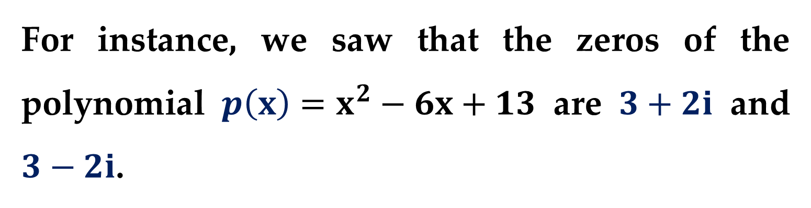
In the previous lecture, we mentioned that the complex zeros of a polynomial with real coefficients occur in conjugate pairs.
For instance, we saw that the zeros of the polynomial $p\left(x\right)=x^{2}−6x+13$ are $3+2i$ and $3−2i$.
In this lecture, we examine some additional properties of complex conjugates.

Slide 4
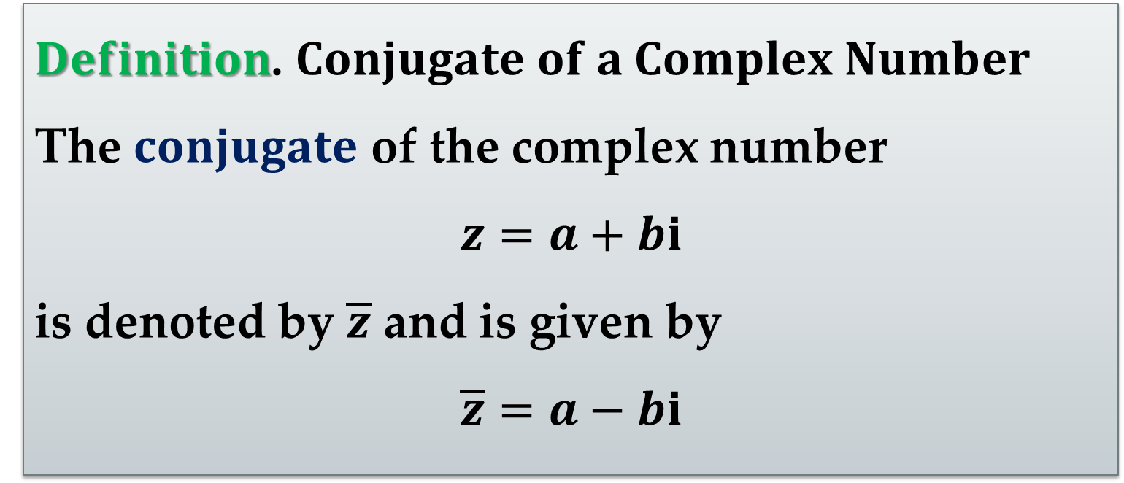
We begin with the definition of the conjugate of a complex number.
$Definition$. $Conjugate of a Complex Number$
The $conjugate$ of the complex number
$$z=a+bi$$
is denoted by $\overline{z}$ and is given by
$$\overline{z}=a−bi$$

Slide 5
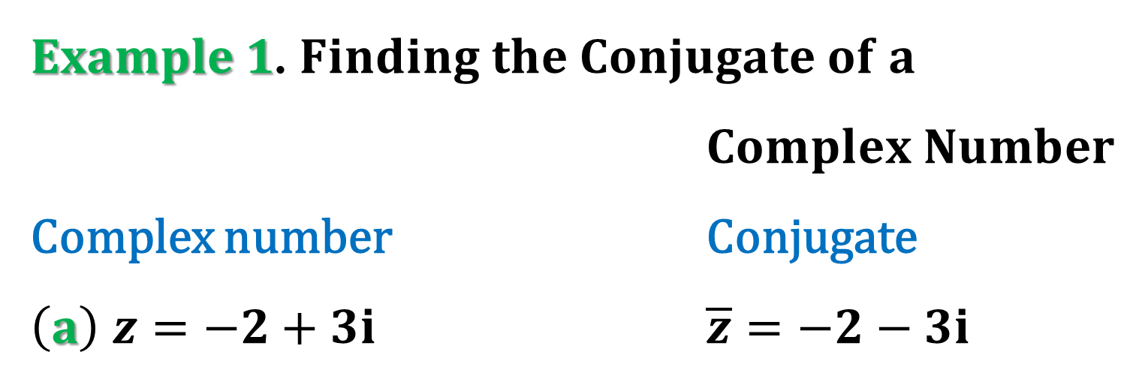
From this definition, we can see that the conjugate of a complex number is found by changing the sign of the imaginary part of the number, as demonstrated in the following example.
$Example 1$. $Finding the Conjugate of a$
$Complex Number$
Complex number Conjugate
$\left(a\right)$ $z=−2+3i$ $\overline{z}=−2−3i$

Slide 6
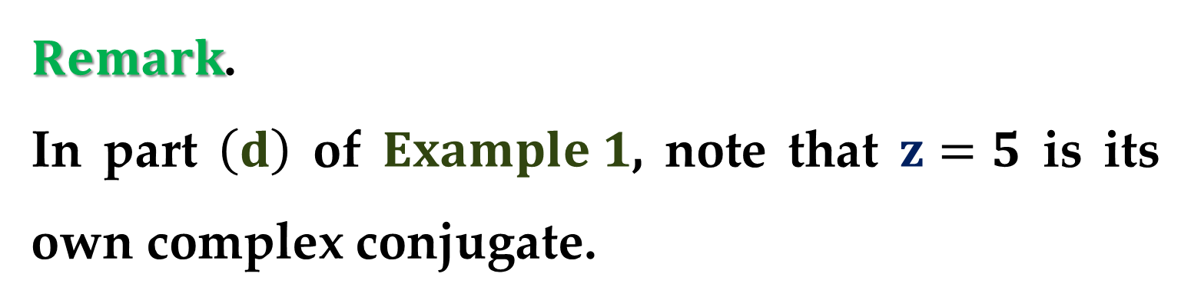
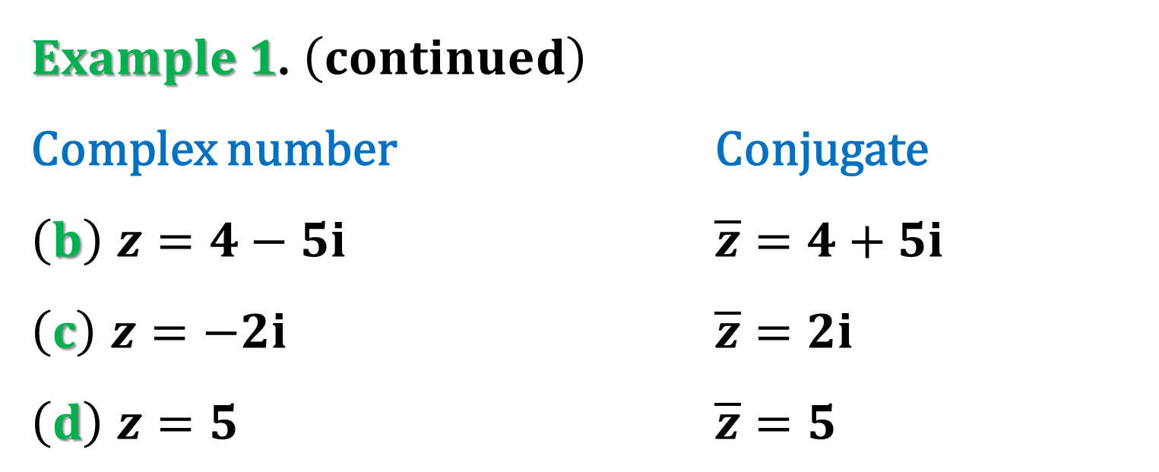
$Example 1$. $\left(continued\right)$
Complex number Conjugate
$\left(b\right)$ $z=4−5i$ $\overline{z}=4+5i$
$\left(c\right)$ $z=−2i$ $\overline{z}=2i$
$\left(d\right)$ $z=5$ $\overline{z}=5$
$Remark$.
In part $\left(d\right)$ of $Example 1$, note that $z=5$ is its own complex conjugate.

Slide 7
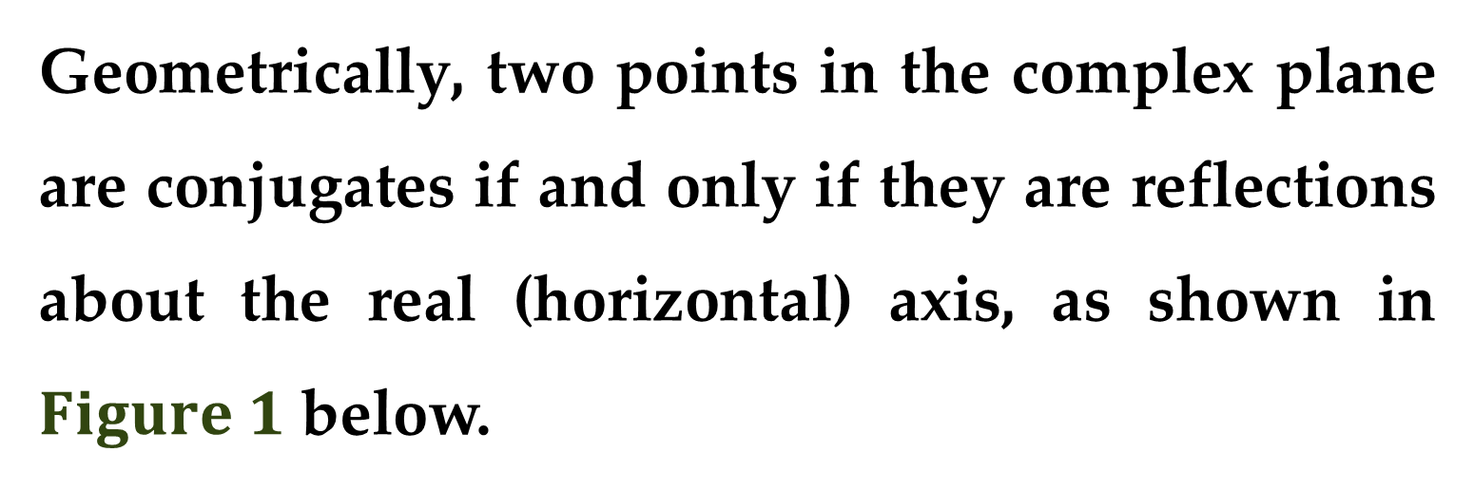
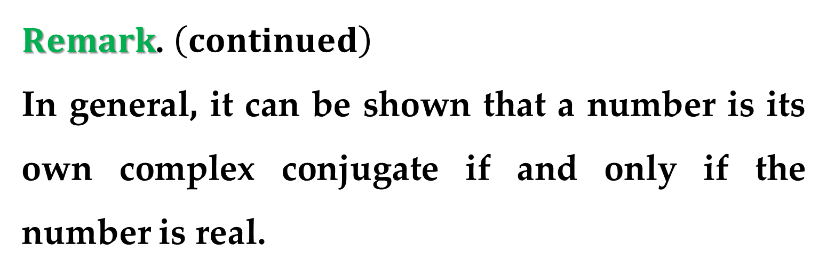
$Remark$. $\left(continued\right)$
In general, it can be shown that a number is its own complex conjugate if and only if the number is real.
Geometrically, two points in the complex plane are conjugates if and only if they are reflections about the real (horizontal) axis, as shown in $Figure 1$ below.

Slide 8
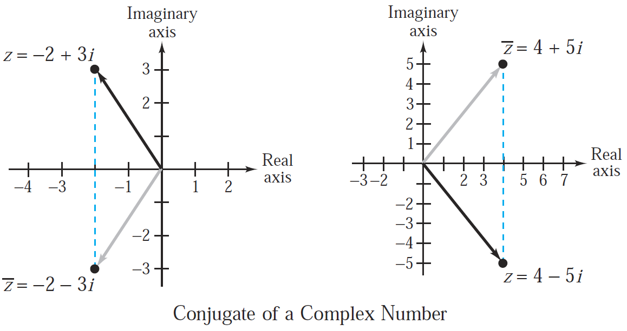
$Figure 1$.

Slide 9
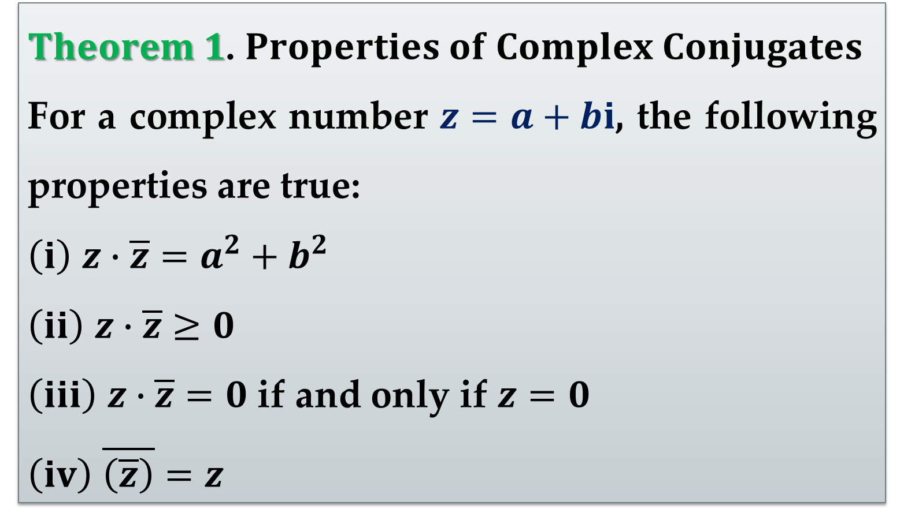
Complex conjugates have many useful properties. Some of these are given in Theorem.
$Theorem 1$. $Properties of Complex Conjugates$
For a complex number $z=a+bi$, the following properties are true:
$\left(i\right)$ $z∙\overline{z}=a^{2}+b^{2}$
$\left(ii\right)$ $z∙\overline{z}≥0$
$\left(iii\right)$ $z∙\overline{z}=0$ if and only if $z=0$
$\left(iv\right)$ $\overline{\left(\overline{z}\right)}=z$

Slide 10
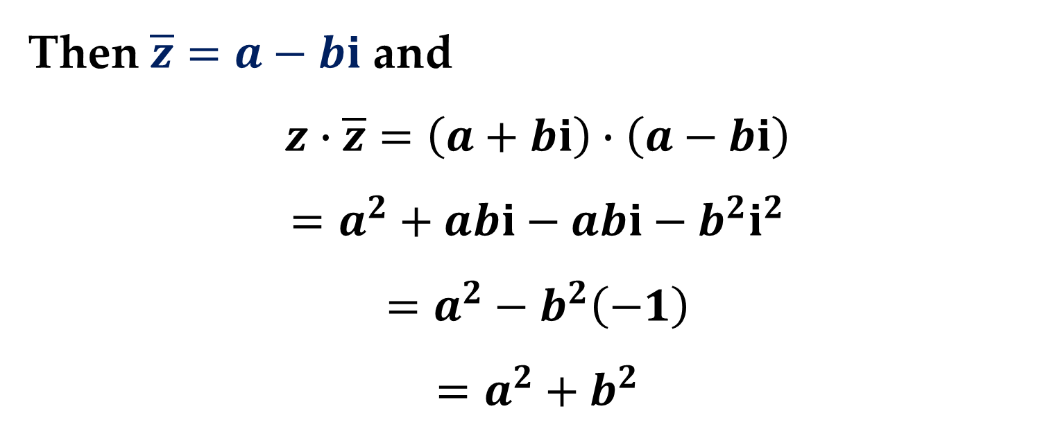
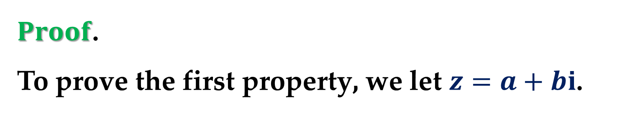
$Proof$.
To prove the first property, we let $z=a+bi$.
Then $\overline{z}=a−bi$ and
$$z∙\overline{z}=\left(a+bi\right)∙\left(a−bi\right)$$
$$=a^{2}+abi−abi−b^{2}i^{2}$$
$$=a^{2}−b^{2}\left(−1\right)$$
$$=a^{2}+b^{2}$$

Slide 11
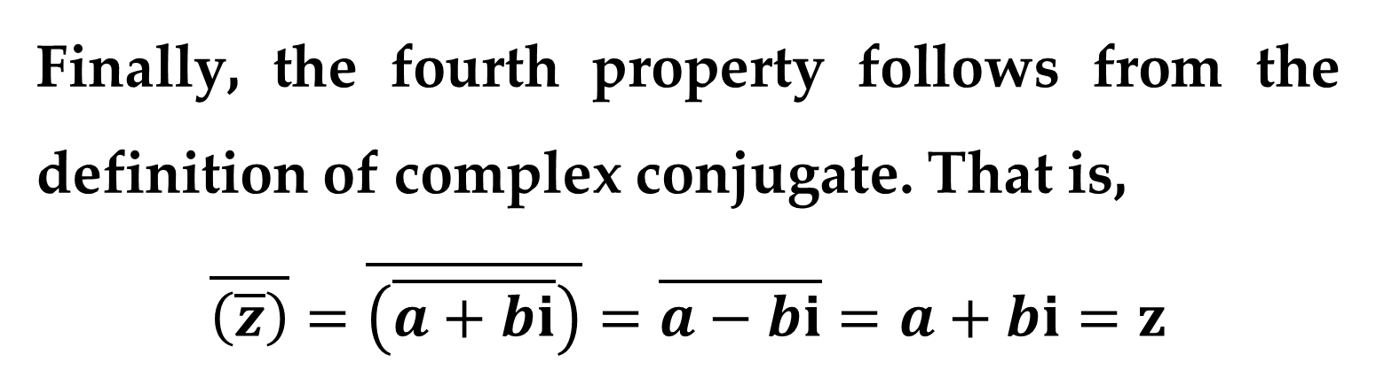
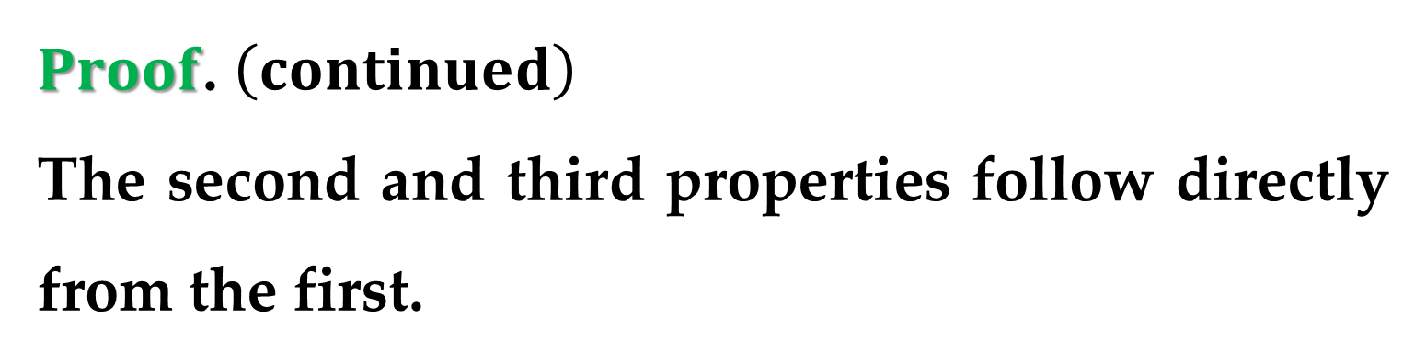
$Proof$. $\left(continued\right)$
The second and third properties follow directly from the first.
Finally, the fourth property follows from the definition of complex conjugate. That is,
$$\overline{\left(\overline{z}\right)}=\overline{\left(\overline{a+bi}\right)}=\overline{a−bi}=a+bi=z$$

Slide 12
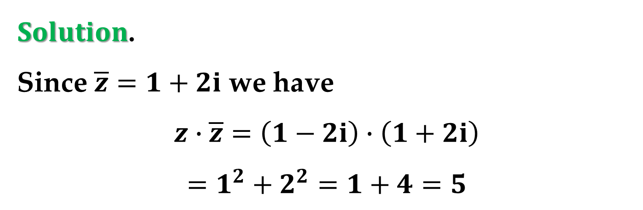
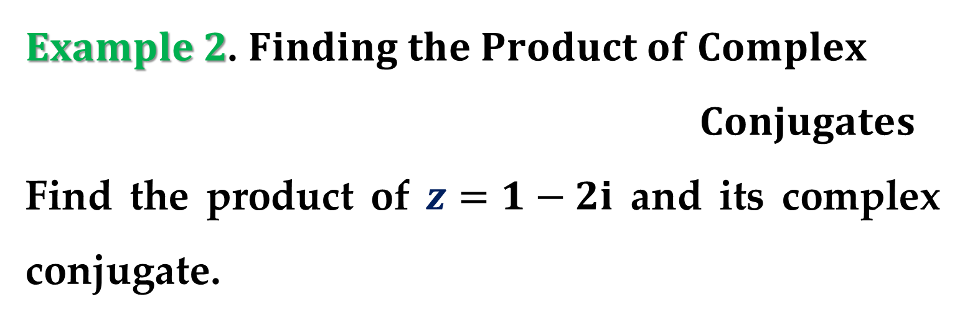
$Example 2$. $Finding the Product of Complex$
$Conjugates$
Find the product of $z=1−2i$ and its complex conjugate.
$Solution$.
Since $\overline{z}=1+2i$ we have
$$z∙\overline{z}=\left(1−2i\right)∙\left(1+2i\right)$$
$$=1^{2}+2^{2}=1+4=5$$

Slide 13
The Modulus of a Complex Number

Slide 14
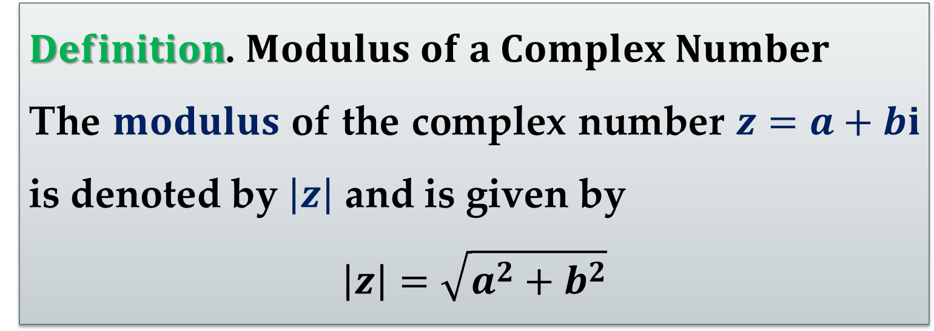
Since a complex number can be represented by a vector in the complex plane, it makes sense to talk about the length of a complex number.
It is called the modulus of the complex number.
$Definition$. $Modulus of a Complex Number$
The $modulus$ of the complex number $z=a+bi$ is denoted by $\left|z\right|$ and is given by
$$\left|z\right|=\sqrt{a^{2}+b^{2}}$$

Slide 15
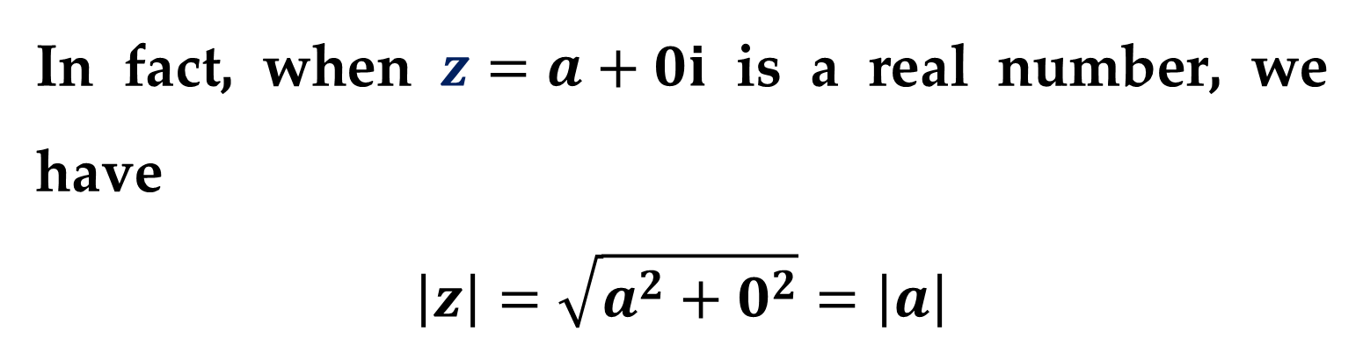
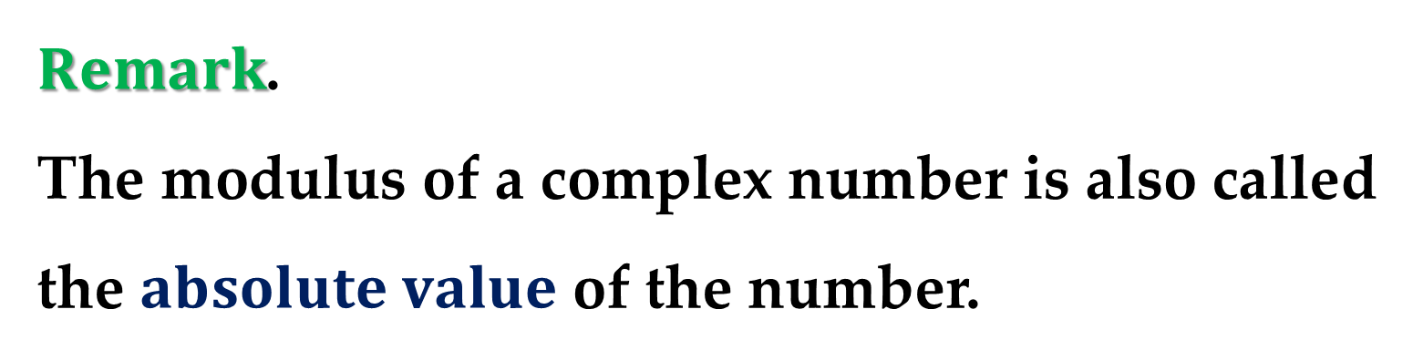
$Remark$.
The modulus of a complex number is also called the $absolute value$ of the number.
In fact, when $z=a+0i$ is a real number, we have
$$\left|z\right|=\sqrt{a^{2}+0^{2}}=\left|a\right|$$

Slide 16
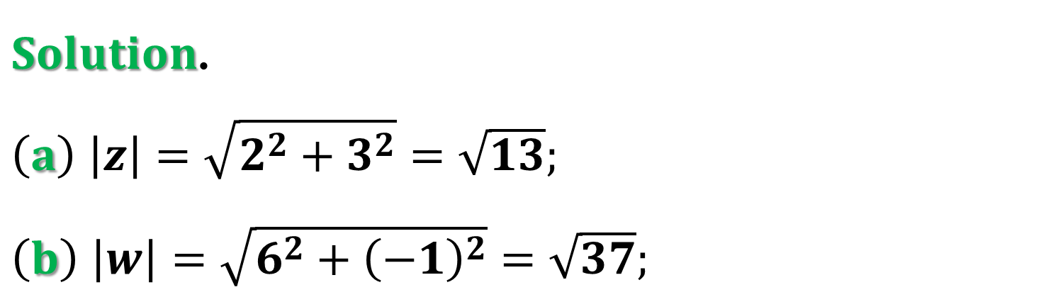
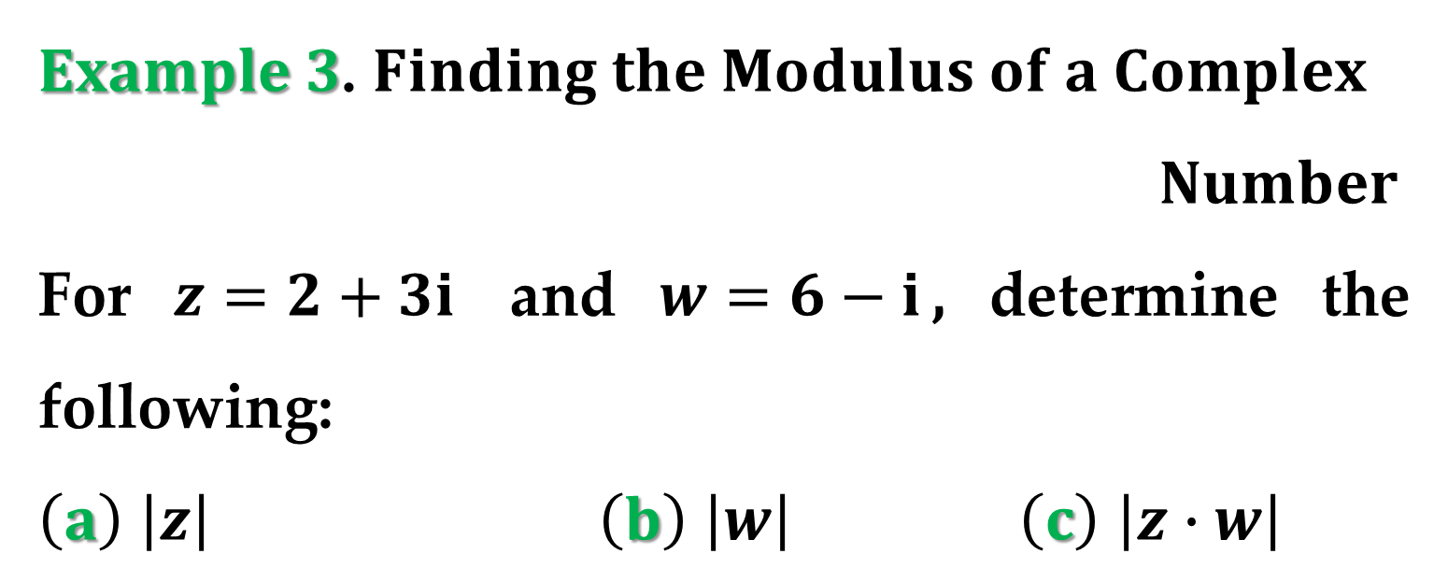
$Example 3$. $Finding the Modulus of a Complex$
$Number$
For $z=2+3i$ and $w=6−i$, determine the following:
$\left(a\right)$ $\left|z\right|$ $\left(b\right)$ $\left|w\right|$ $\left(c\right)$ $\left|z∙w\right|$
$Solution$.
$\left(a\right)$ $\left|z\right|=\sqrt{2^{2}+3^{2}}=\sqrt{13};$
$\left(b\right)$ $\left|w\right|=\sqrt{6^{2}+{\left(−1\right)}^{2}}=\sqrt{37};$

Slide 17
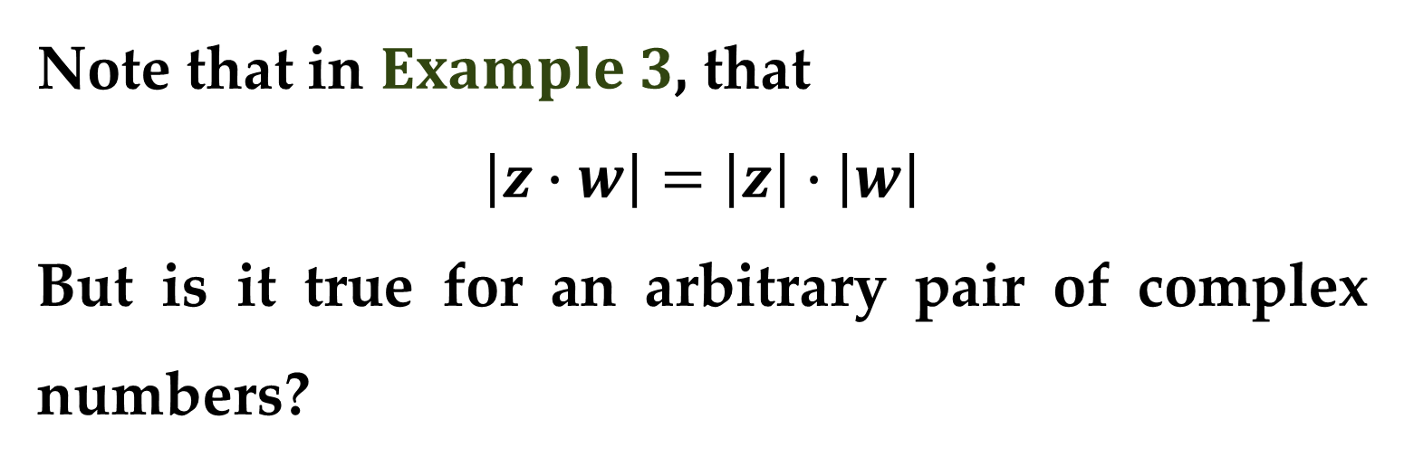
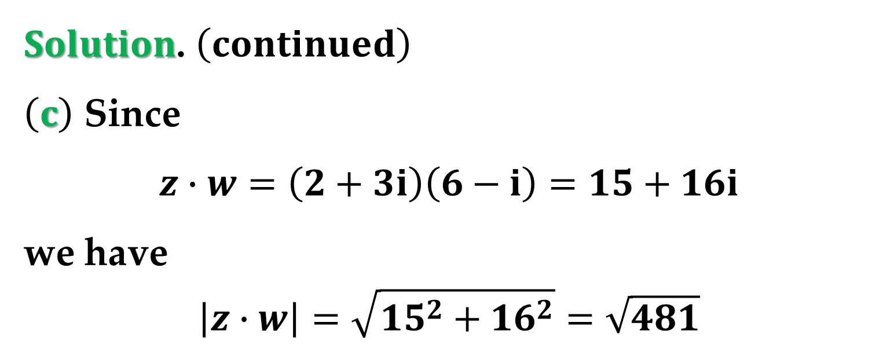
$Solution$. $\left(continued\right)$
$\left(c\right)$ Since
$$z∙w=\left(2+3i\right)\left(6−i\right)=15+16i$$
we have
$$\left|z∙w\right|=\sqrt{15^{2}+16^{2}}=\sqrt{481}$$
Note that in $Example 3$, that
$$\left|z∙w\right|=\left|z\right|∙\left|w\right|$$
But is it true for an arbitrary pair of complex numbers?

Slide 18
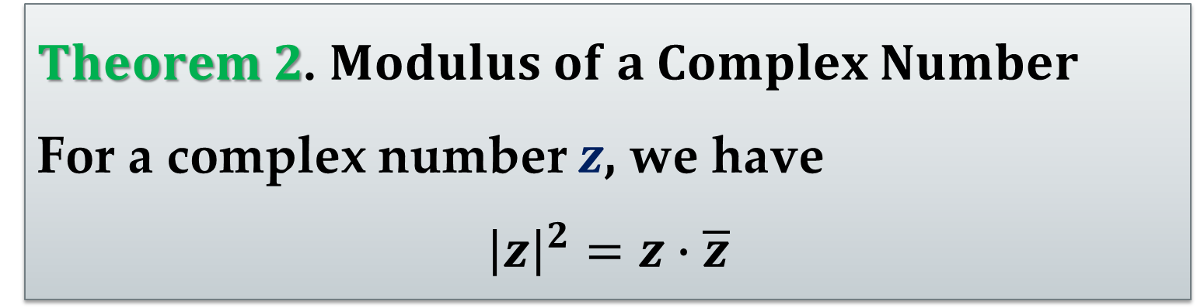
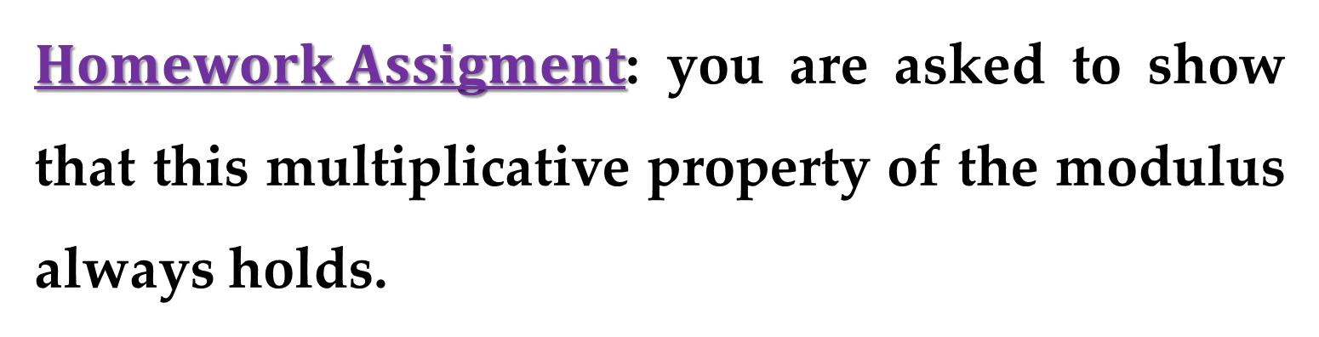
$Homework Assigment$: you are asked to show that this multiplicative property of the modulus always holds.
The modulus of a complex number is related to its conjugate in the following way.
$Theorem 2$. $Modulus of a Complex Number$
For a complex number $z$, we have
$${\left|z\right|}^{2}=z∙\overline{z}$$

Slide 19
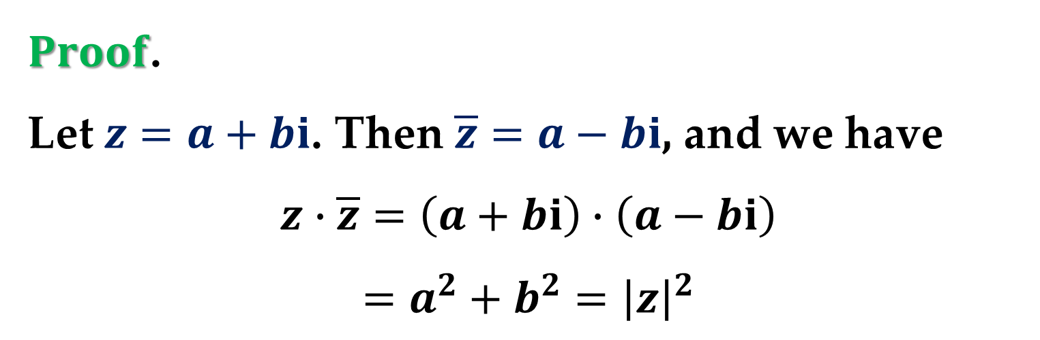
$Proof$.
Let $z=a+bi$. Then $\overline{z}=a−bi$, and we have
$$z∙\overline{z}=\left(a+bi\right)∙\left(a−bi\right)$$
$$=a^{2}+b^{2}={\left|z\right|}^{2}$$

Slide 20
Division of Complex Numbers

Slide 21

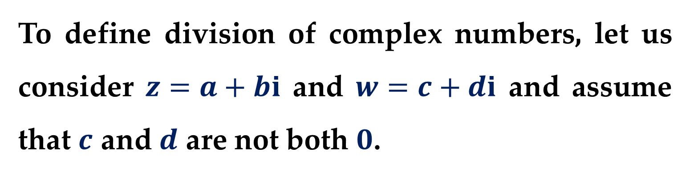
One of the most important uses of the conjugate of a complex number is in performing division in the complex number system.
To define division of complex numbers, let us consider $z=a+bi$ and $w=c+di$ and assume that $c$ and $d$ are not both $0$.
Consider the quotient
$$\frac{z}{w}=x+yi$$

Slide 22
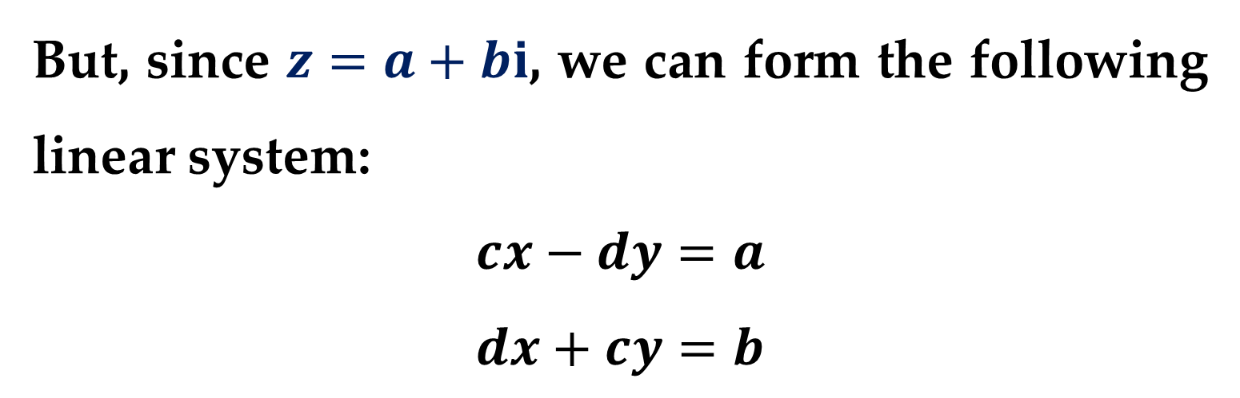
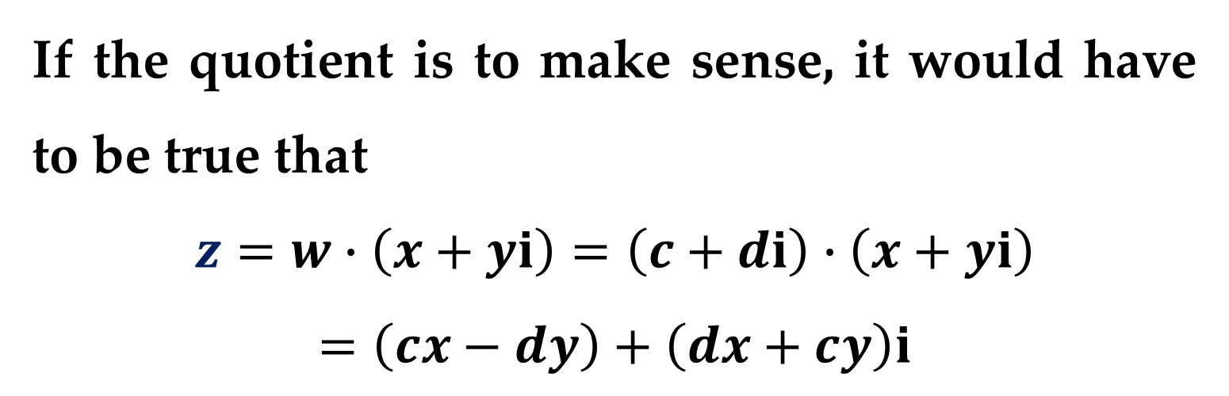
If the quotient is to make sense, it would have to be true that
$$z=w∙\left(x+yi\right)=\left(c+di\right)∙\left(x+yi\right)$$
$$=\left(cx−dy\right)+\left(dx+cy\right)i$$
But, since $z=a+bi$, we can form the following linear system:
$$cx−dy=a$$
$$dx+cy=b$$

Slide 23
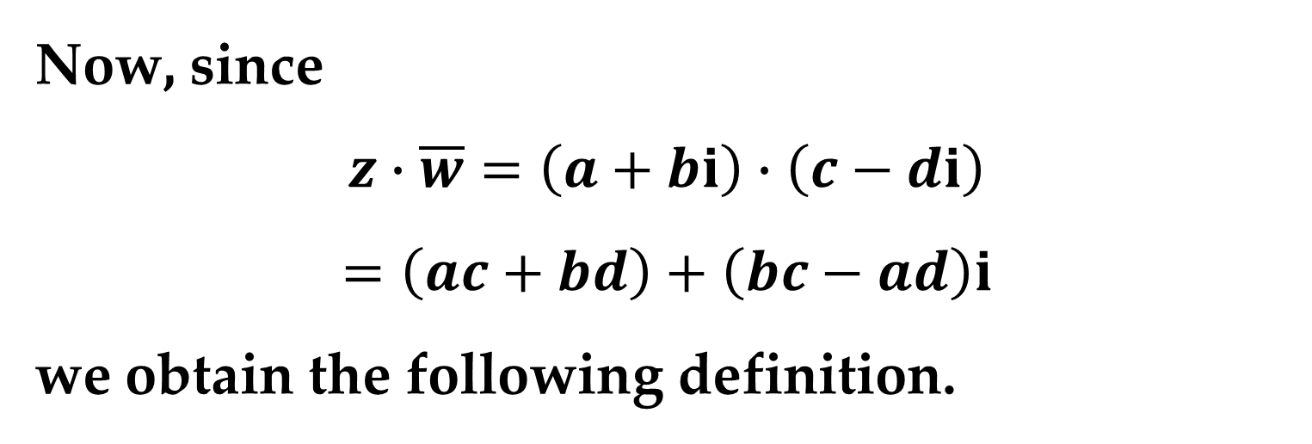
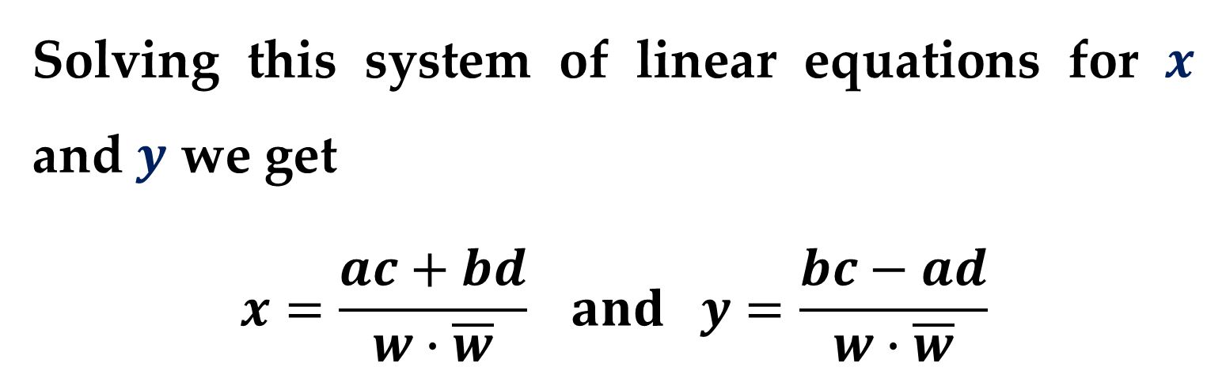
Solving this system of linear equations for $x$ and $y$ we get
$$x=\frac{ac+bd}{w∙\overline{w}} and y=\frac{bc−ad}{w∙\overline{w}}$$
Now, since
$$z∙\overline{w}=\left(a+bi\right)∙\left(c−di\right)$$
$$=\left(ac+bd\right)+\left(bc−ad\right)i$$
we obtain the following definition.

Slide 24
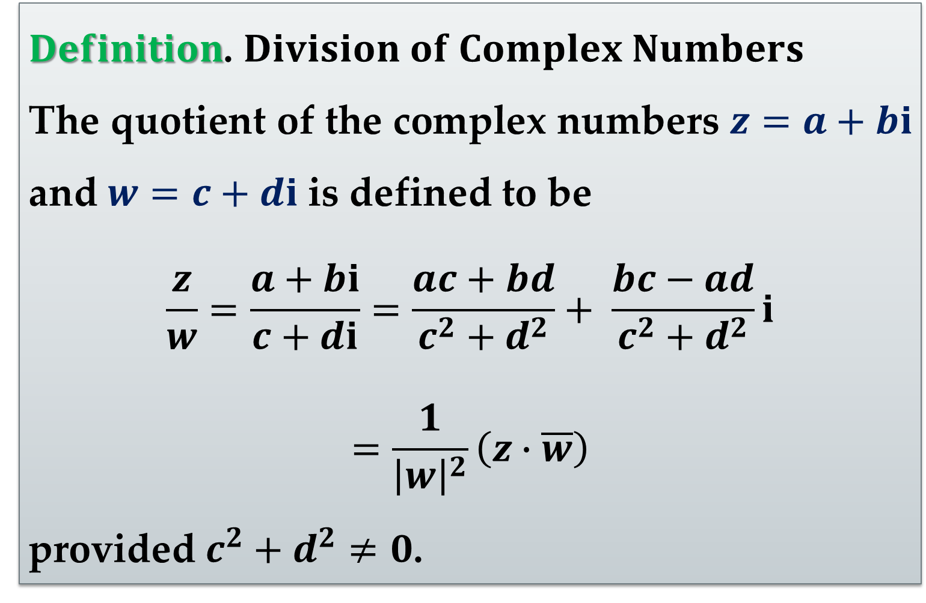
$Definition$. $Division of Complex Numbers$
The quotient of the complex numbers $z=a+bi$ and $w=c+di$ is defined to be
$$\frac{z}{w}=\frac{a+bi}{c+di}=\frac{ac+bd}{c^{2}+d^{2}}+ \frac{bc−ad}{c^{2}+d^{2}}i$$
$$=\frac{1}{{\left|w\right|}^{2}}\left(z∙\overline{w}\right)$$
provided $c^{2}+d^{2}≠0$.

Slide 25
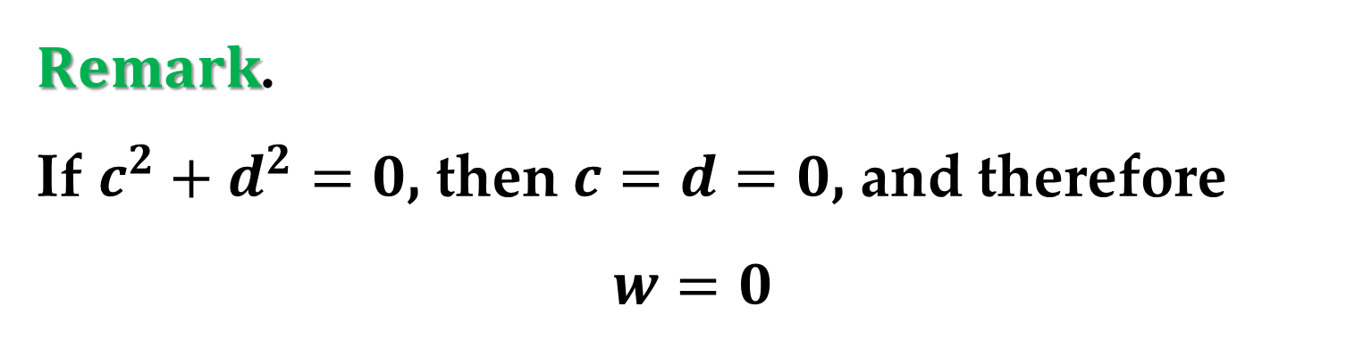
$Remark$.
If $c^{2}+d^{2}=0$, then $c=d=0$, and therefore
$$w=0$$
In other words, just as is the case with real numbers, division of complex numbers by zero is not defined.

Slide 26
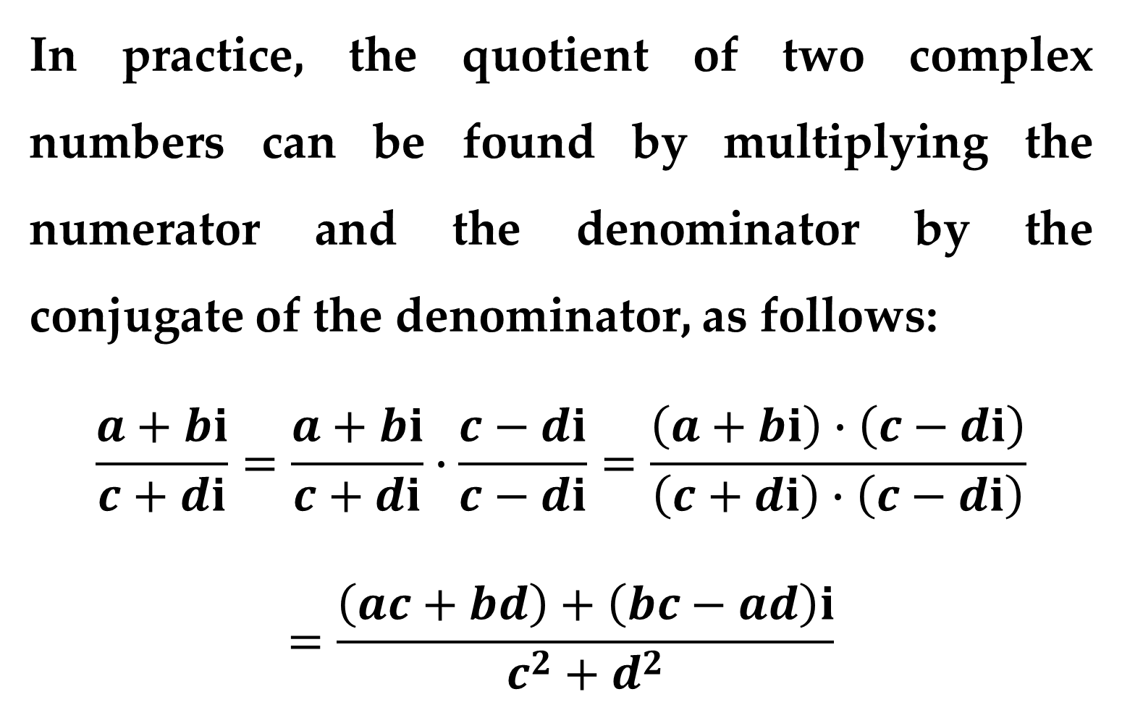
In practice, the quotient of two complex numbers can be found by multiplying the numerator and the denominator by the conjugate of the denominator, as follows:
$$\frac{a+bi}{c+di}=\frac{a+bi}{c+di}∙\frac{c−di}{c−di}=\frac{\left(a+bi\right)∙\left(c−di\right)}{\left(c+di\right)∙\left(c−di\right)}$$
$$=\frac{\left(ac+bd\right)+\left(bc−ad\right)i}{c^{2}+d^{2}}$$

Slide 27
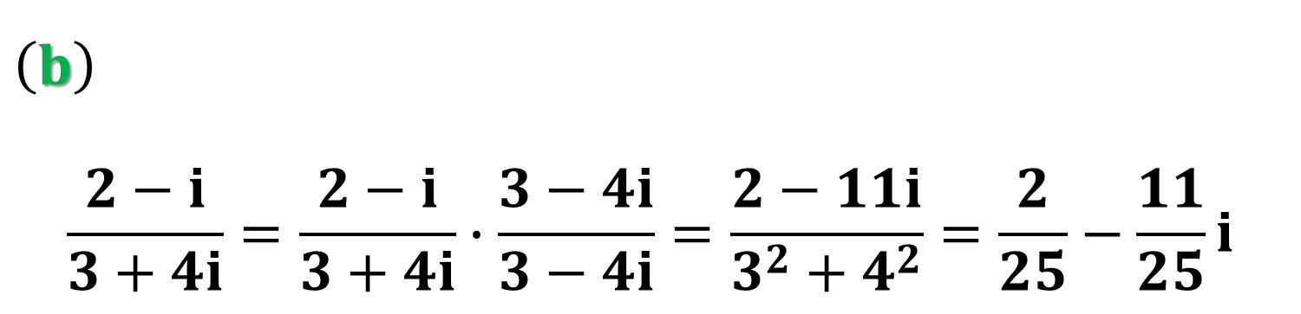
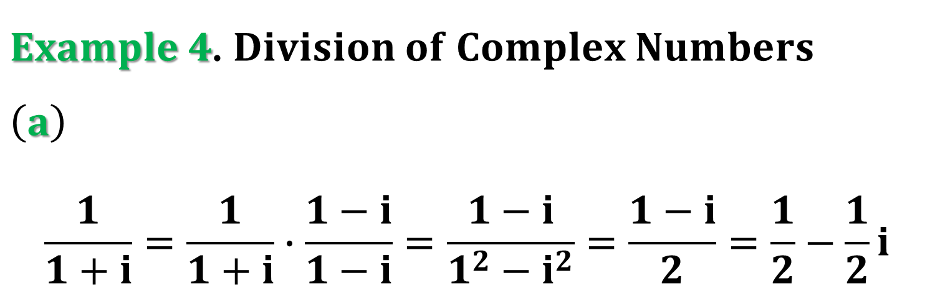
$Example 4$. $Division of Complex Numbers$
$\left(a\right)$
$$\frac{1}{1+i}=\frac{1}{1+i}∙\frac{1−i}{1−i}=\frac{1−i}{1^{2}−i^{2}}=\frac{1−i}{2}=\frac{1}{2}−\frac{1}{2}i$$
$\left(b\right)$
$$\frac{2−i}{3+4i}=\frac{2−i}{3+4i}∙\frac{3−4i}{3−4i}=\frac{2−11i}{3^{2}+4^{2}}=\frac{2}{25}−\frac{11}{25}i$$

Slide 28
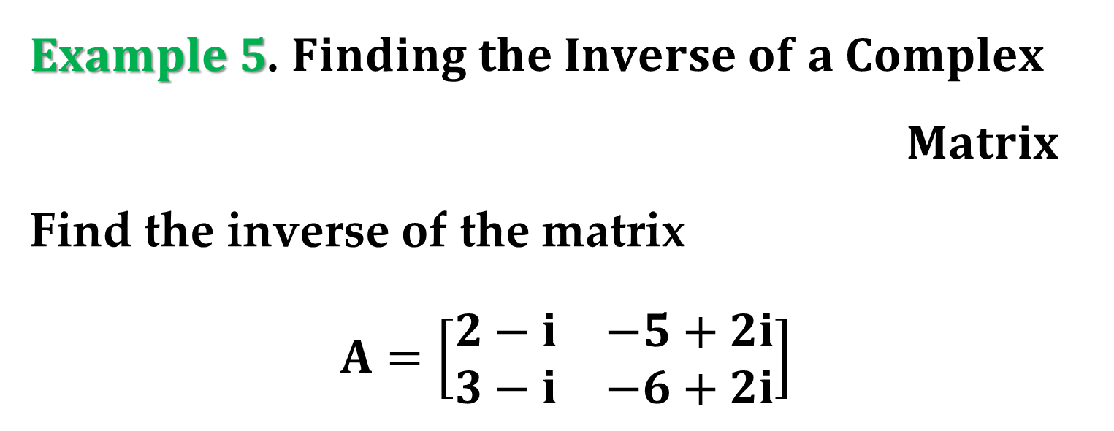
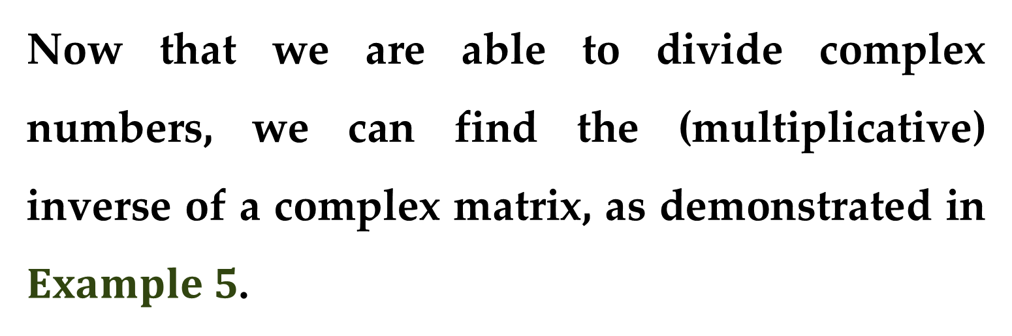
Now that we are able to divide complex numbers, we can find the (multiplicative) inverse of a complex matrix, as demonstrated in $Example 5$.
$Example 5$. $Finding the Inverse of a Complex$
$Matrix$
Find the inverse of the matrix
$$A=\left[\begin{matrix}2−i & −5+2i \\ 3−i & −6+2i\end{matrix}\right]$$

Slide 29
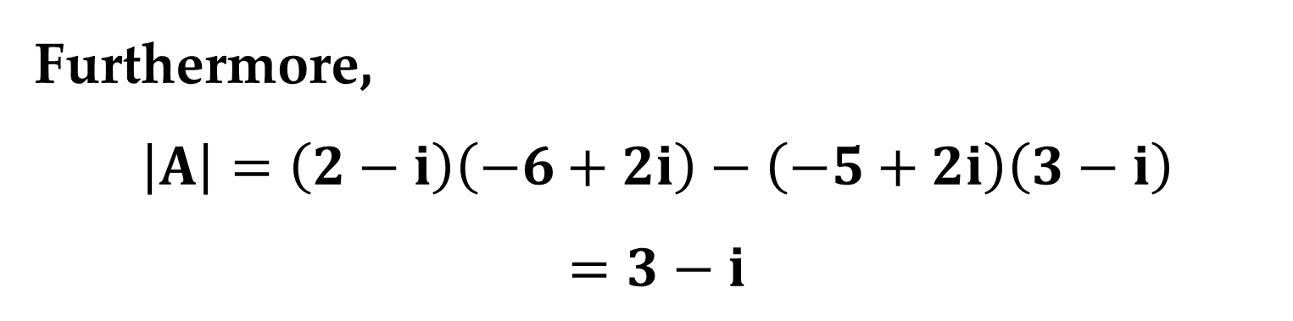
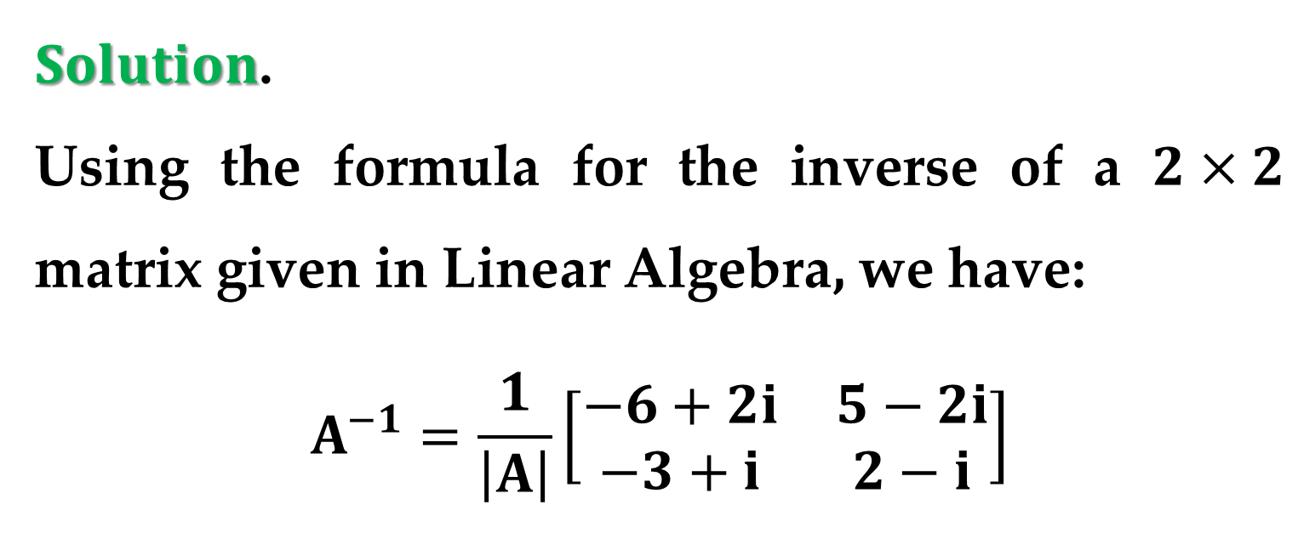
$Solution$.
Using the formula for the inverse of a $2×2$ matrix given in Linear Algebra, we have:
$$A^{−1}=\frac{1}{\left|A\right|}\left[\begin{matrix}−6+2i & 5−2i \\ −3+i & 2−i\end{matrix}\right]$$
Furthermore,
$$\left|A\right|=\left(2−i\right)\left(−6+2i\right)−\left(−5+2i\right)\left(3−i\right)$$
$$=3−i$$

Slide 30
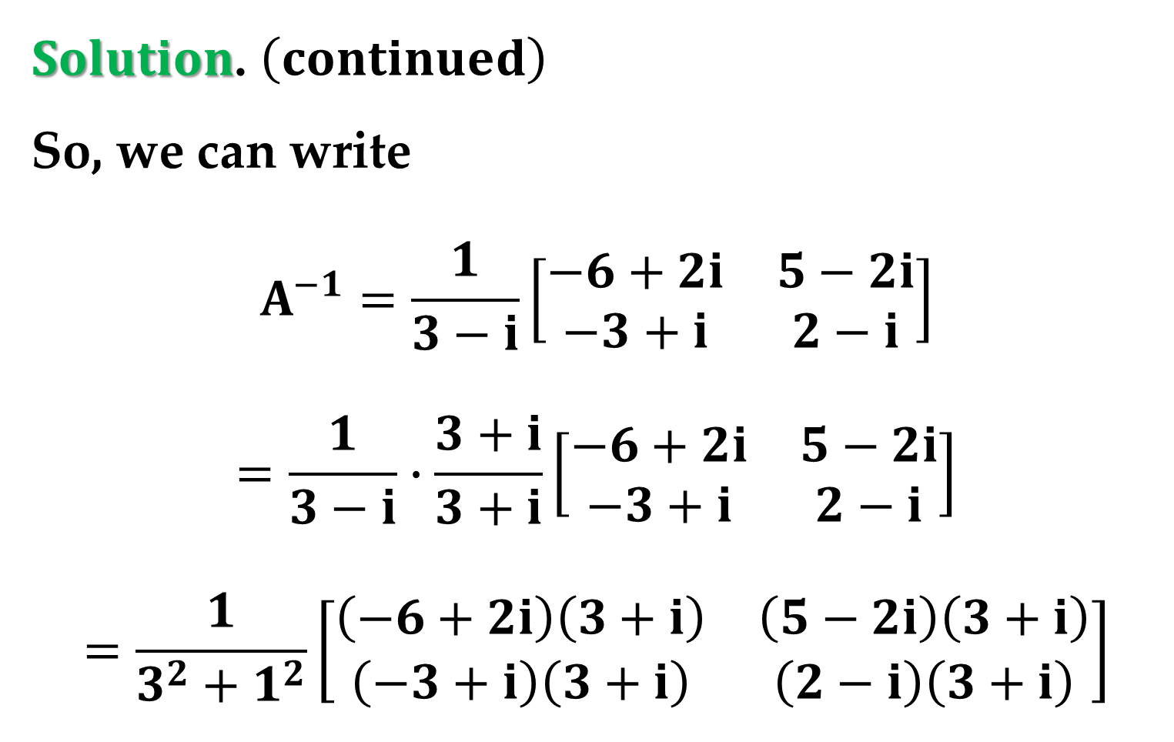
$Solution$. $\left(continued\right)$
So, we can write
$$A^{−1}=\frac{1}{3−i}\left[\begin{matrix}−6+2i & 5−2i \\ −3+i & 2−i\end{matrix}\right]$$
$$=\frac{1}{3−i}∙\frac{3+i}{3+i}\left[\begin{matrix}−6+2i & 5−2i \\ −3+i & 2−i\end{matrix}\right]$$
$$=\frac{1}{3^{2}+1^{2}}\left[\begin{matrix}\left(−6+2i\right)\left(3+i\right) & \left(5−2i\right)\left(3+i\right) \\ \left(−3+i\right)\left(3+i\right) & \left(2−i\right)\left(3+i\right)\end{matrix}\right]$$

Slide 31
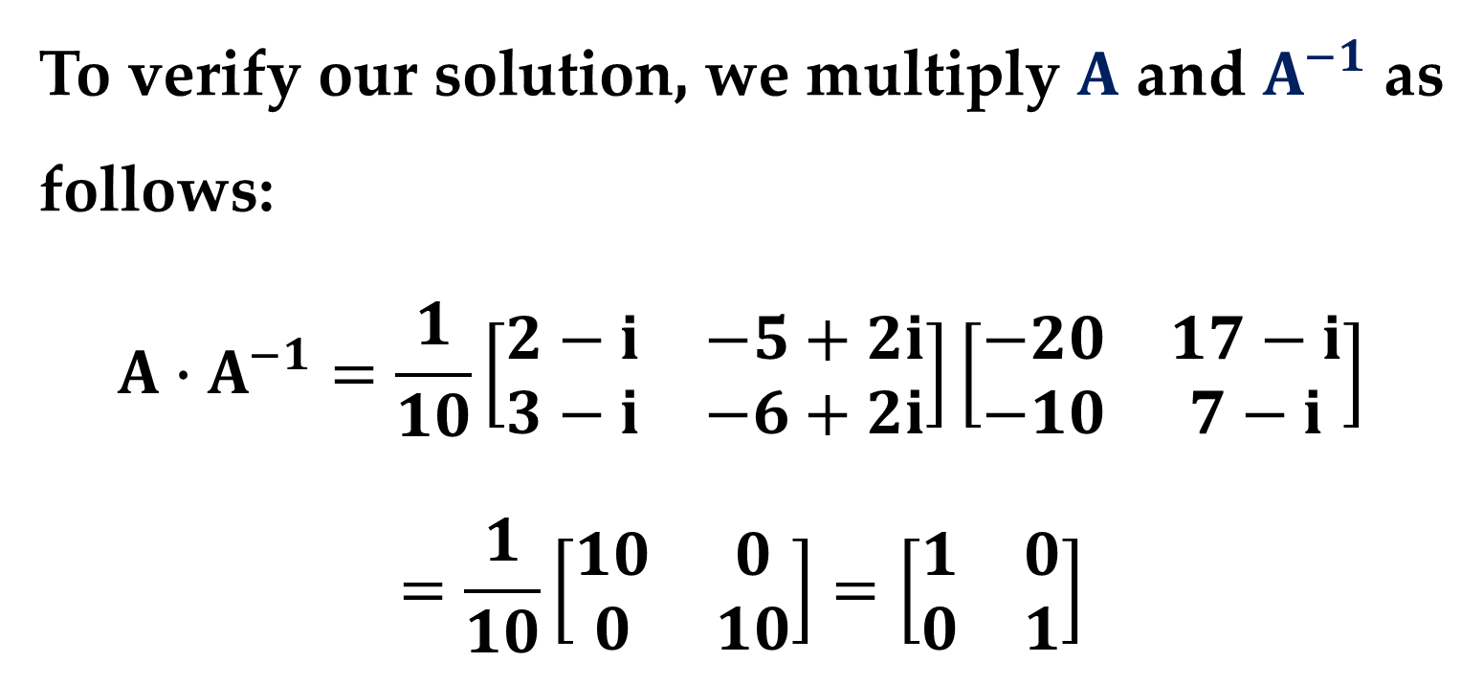

$Solution$. $\left(continued\right)$
$$A^{−1}=\frac{1}{10}\left[\begin{matrix}−20 & 17−i \\ −10 & 7−i\end{matrix}\right]$$
To verify our solution, we multiply $A$ and $A^{−1}$ as follows:
$$A∙A^{−1}=\frac{1}{10}\left[\begin{matrix}2−i & −5+2i \\ 3−i & −6+2i\end{matrix}\right]\left[\begin{matrix}−20 & 17−i \\ −10 & 7−i\end{matrix}\right]$$
$$=\frac{1}{10}\left[\begin{matrix}10 & 0 \\ 0 & 10\end{matrix}\right]=\left[\begin{matrix}1 & 0 \\ 0 & 1\end{matrix}\right]$$

Slide 32
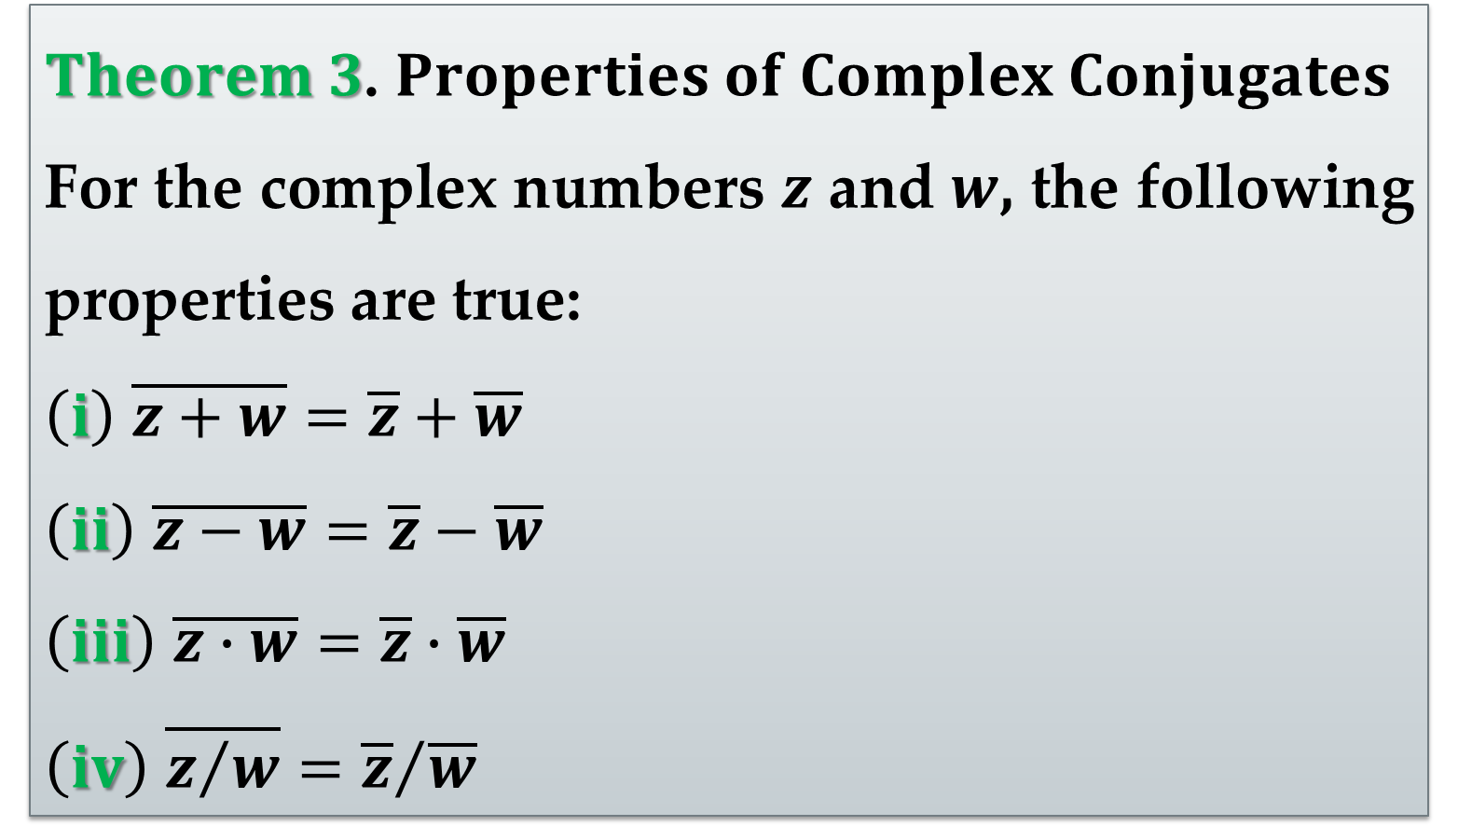
The last theorem in this lecture summarizes some useful properties of complex conjugates.
$Theorem 3$. $Properties of Complex Conjugates$
For the complex numbers $z$ and $w$, the following properties are true:
$\left(i\right)$ $\overline{z+w}=\overline{z}+\overline{w}$
$\left(ii\right)$ $\overline{z−w}=\overline{z}−\overline{w}$
$\left(iii\right)$ $\overline{z∙w}=\overline{z}∙\overline{w}$
$\left(iv\right)$ $\overline{z/w}={\overline{z}}/{\overline{w}}$

Slide 33
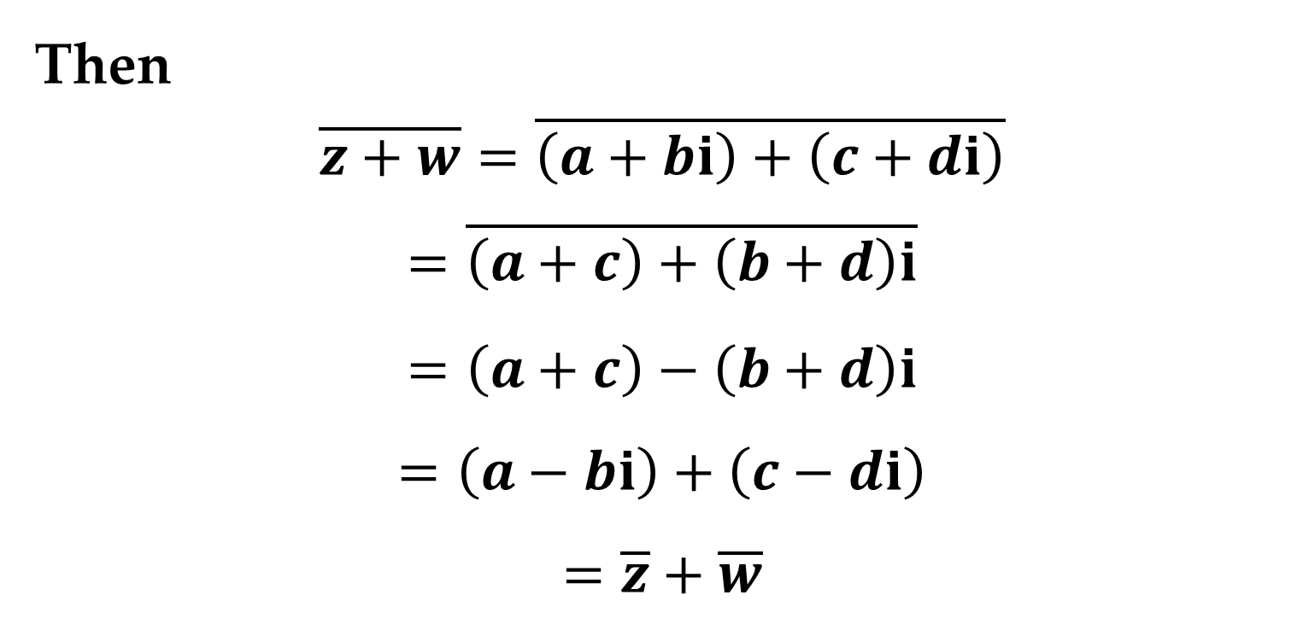
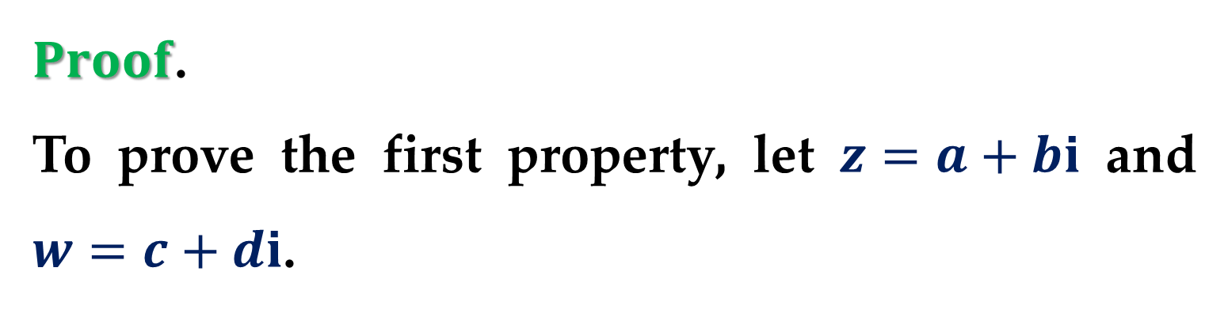
$Proof$.
To prove the first property, let $z=a+bi$ and $w=c+di$.
Then
$$\overline{z+w}=\overline{\left(a+bi\right)+\left(c+di\right)}$$
$$=\overline{\left(a+c\right)+\left(b+d\right)i}$$
$$=\left(a+c\right)−\left(b+d\right)i$$
$$=\left(a−bi\right)+\left(c−di\right)$$
$$=\overline{z}+\overline{w}$$

Slide 34
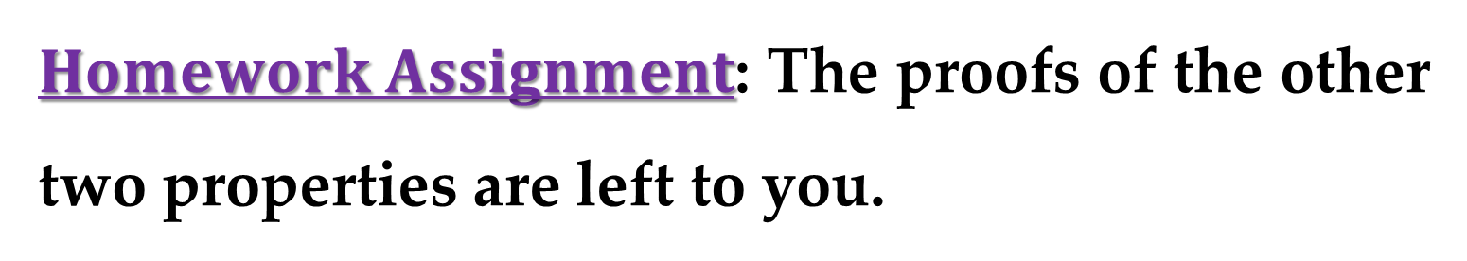
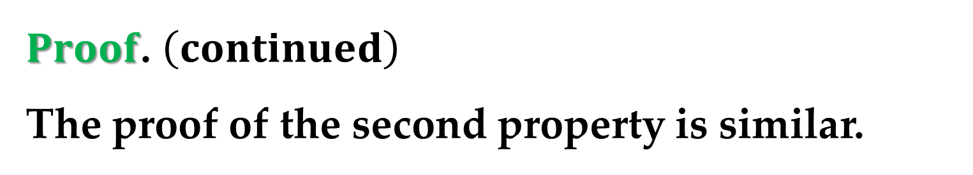
$Proof$. $\left(continued\right)$
The proof of the second property is similar.
$Homework Assignment$: The proofs of the other two properties are left to you.

Slide 35
Thank you for attention!

